Slide 1
Impact of Universities’ Online Covid-19 Dashboards on County Covid Cases
Alex Coble & Joe Moran
STAT 571 | Data Science Live | April 30, 2021

Slide 2
Presentation Outline
outline
Background information and motivation
Research questions and goals
Description of our data
Exploratory analysis
Additional data collection through web scraping
Three main tests:
7-Day Event Study
14-Day Event Study
Difference in Differences Design

Slide 3

Covid-19’s Effect on Universities
background
The onset of the pandemic forced many universities to close their doors to students in March 2020 across the nation and worldwide
As the pandemic continued, a large variation in university policies for the Fall 2020 semester emerged. Some schools offered courses in person while others adopted a hybrid format or moved fully online.

Slide 4
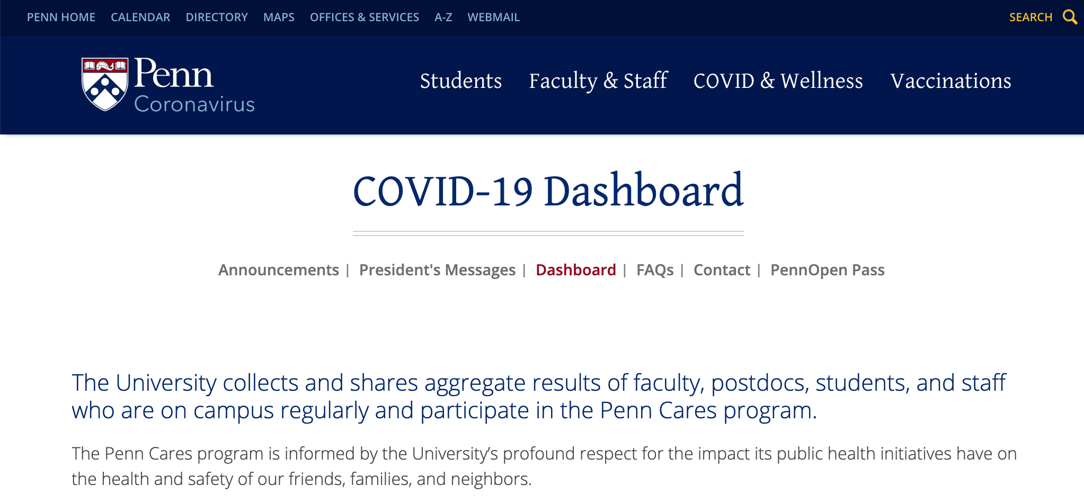
University Covid Dashboards
background
Many universities created webpages completely dedicated to tracking and monitoring the number of covid cases among their population of students, faculty, and staff (“dashboards”)
U Penn’s dashboard: https://coronavirus.upenn.edu/content/dashboard

Slide 5
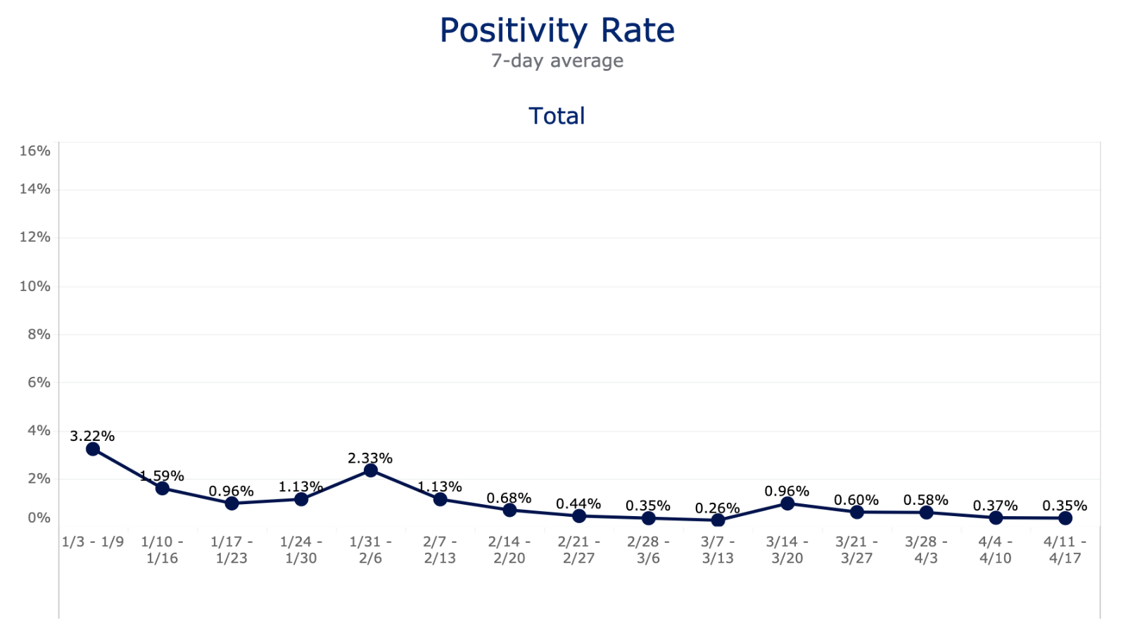
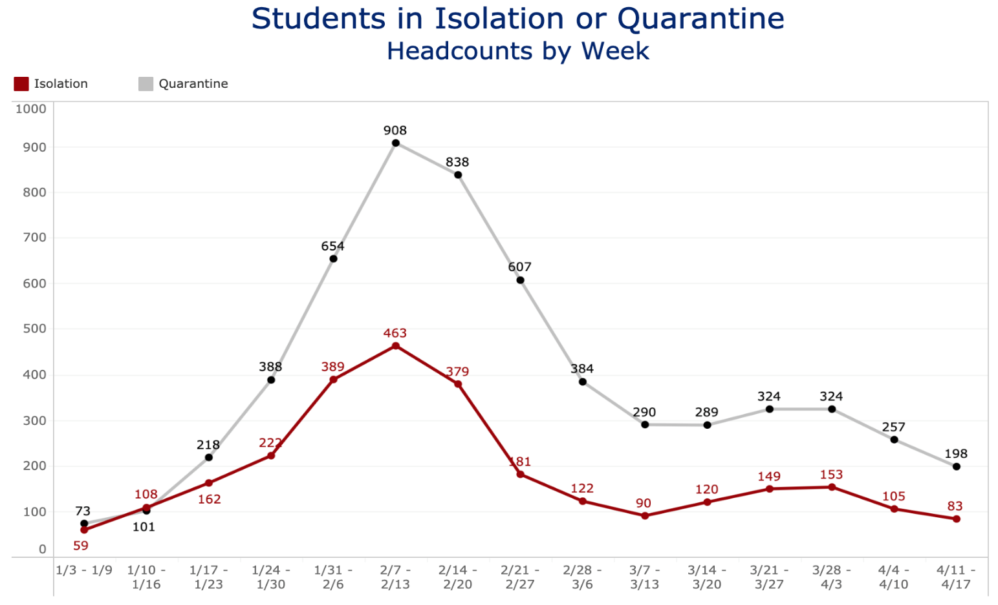
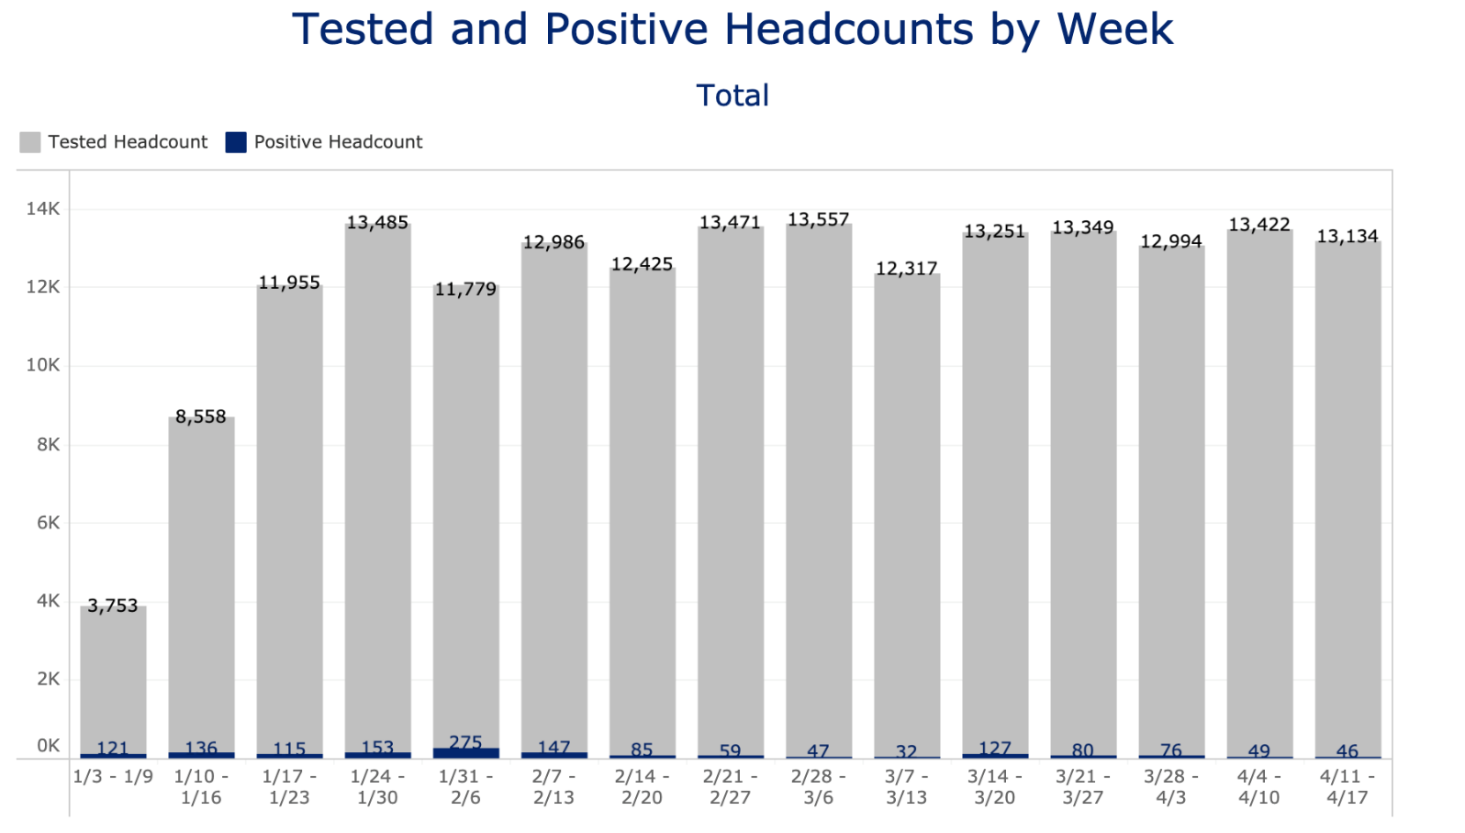
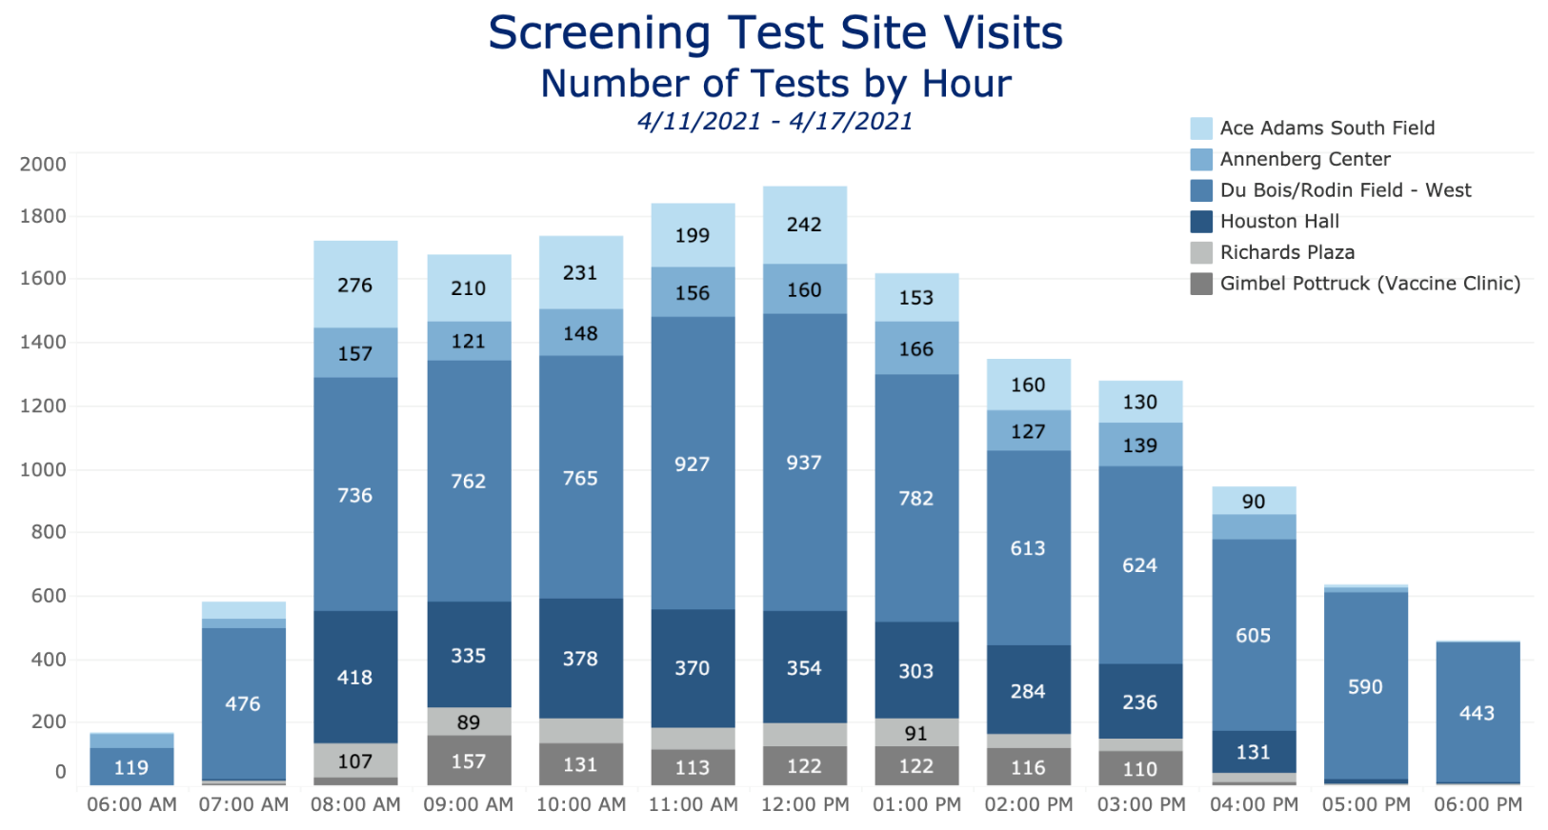
background
background
U Penn’s dashboard: https://coronavirus.upenn.edu/content/dashboard

Slide 6
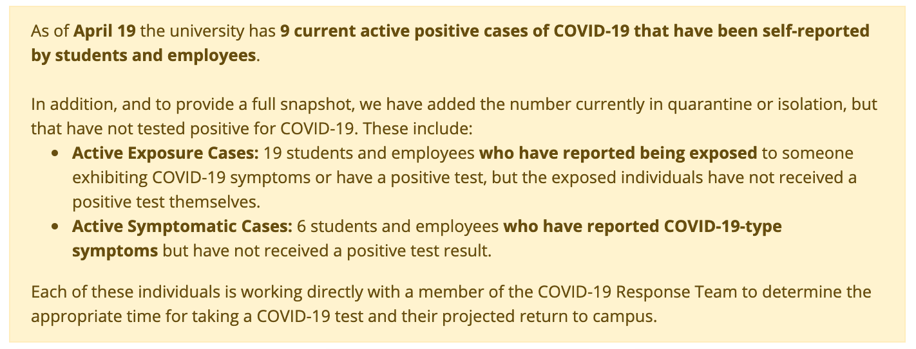
Variation in Dashboards
background
Large variation in the information content and quality of disclosure in these covid dashboards across universities
U Penn’s dashboard is quite extensive, but some universities have dashboards with very limited information (or may not possess a dashboard at all)
Columbus State University’s (GA) dashboard: https://www.columbusstate.edu/covid/self-report-tracking.php

Slide 7

Research Questions
goal
How do changes made to university covid dashboards affect the spread of covid-19 in the surrounding county? → Event study
Do universities that track cases on covid dashboards do better (i.e. have fewer cases) than universities that do not once the Fall 2020 semester begins? → Difference in differences

Slide 8
Our Datasets
data
List of 598 U.S. universities conducting operations in person or using a hybrid model during Fall 2020 indicating the county in which it resides and the school’s covid plan || Source: College Crisis Initiative

Slide 9
Our Datasets
data
Website URLs of the online covid dashboards for each university (if applicable) || Source: Hand collected
Date instruction began in Fall 2020 for each university conducting operations in-person || Source: Hand collected
U.S. daily covid cases by county for the period June 1, 2020 to November 24, 2020 || Source: New York Times
University-specific attributes as of Fall 2019 (e.g., graduation rate, enrollment, school type) || Source: IPEDS

Slide 10
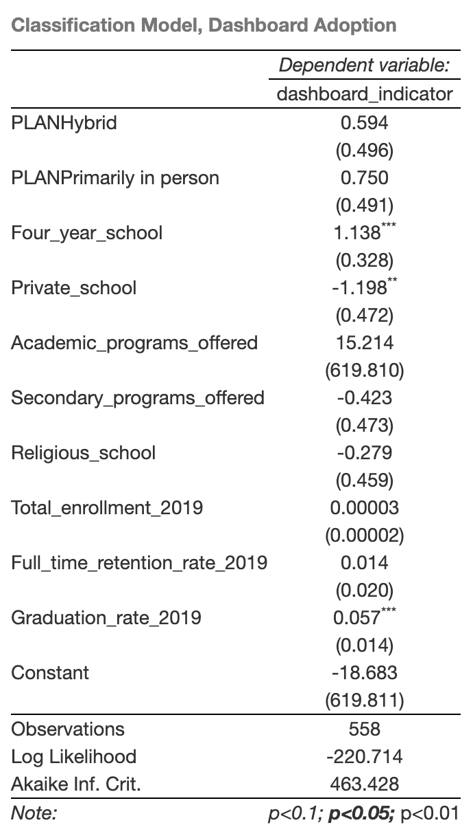
Logit Model
Exploratory analysis
What factors influence a university’s decision to provide a covid dashboard?
We used LASSO to produce a sparse model that identifies important factors related to a university’s decision to provide a covid dashboard.
We then use the 10 variables LASSO identified as our control variables in our subsequent tests (incl. one categorical variable not shown here).
Dependent variable: Indicator variable equal to 1 if the university provides a covid dashboard (0 otherwise)
Independent variables: Various university specific factors available on College Crisis Initiative

Slide 11

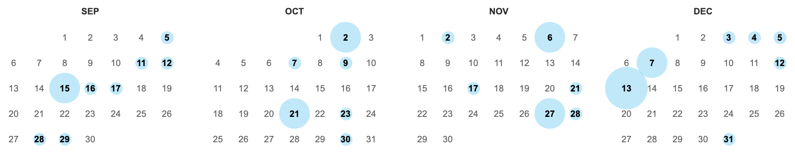
Measuring Changes Made to Dashboards
Data Collection
We first used the Wayback Machine Internet Archive (available at archive.org) to retrieve web scrapes of historical HTML versions of each university’s covid dashboard.
Days on which U Penn’s covid dashboard was scraped by the Wayback Machine

Slide 12
Measuring Changes Made to Dashboards
Data Collection
We then created 5 measures of the informativeness (as proxied by the amount of HTML content) of university dashboards:
1
Number of characters
2
Number of hyperlinks (linked webpages)
Combined all 5 measures into a single factor using PCA
3
Number of rich content nodes
4
Number of dynamic content nodes
5
Number of formatting nodes
We then calculate the change in the PC1 factor between web scrape dates for each university dashboard.
We then create a series of indicator variables to identify dates representing PC1 factor changes in the top 10%, 20%, 25%, 33%, and 50% quantile of the distribution.

Slide 13
7- and 14-Day Event Study
Tests 1-2
What is an event study?
Event studies use linear regressions to examine how a dependent variable (i.e. covid case rates) changes during a short time window following an event (i.e. a large change to a university covid dashboard).
Covid cases = α + β₁(Indicator variable for time window) + β(Controls) + β(FIPS, month fixed effects) + ε
What are fixed effects?
Fixed effects are equivalent to adding a dummy variable for each level of a categorical variable. This causes the results of the regression to have a within-group interpretation, as the dummies capture category-specific effects on the dependent variable.

Slide 14
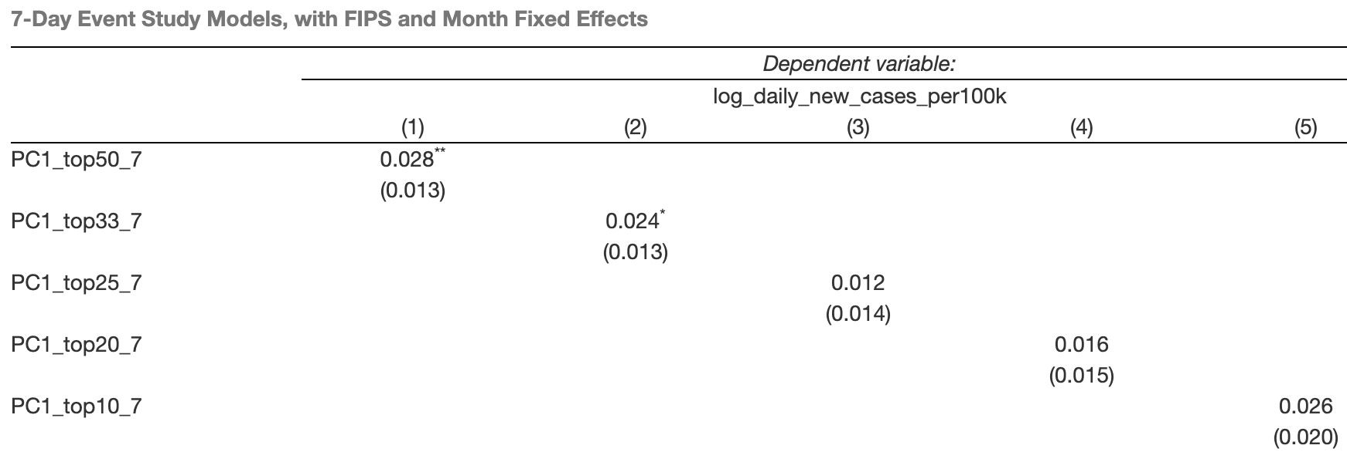
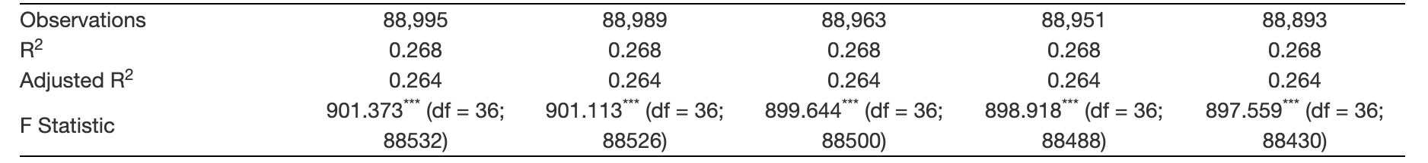
7- and 14-Day Event Study
Tests 1-2
Independent variable: Indicator variable which equals 1 during the [0, +7] day period after a change in the PC1 factor in either the top 10%, 20%, 25%, 33%, or 50% quantile
Dependent variable: Log of daily new county cases per 100k
Fixed effects: County (FIPS), Month
Other controls: Average cases during the [-3, -1] day period & relevant university specific variables identified using LASSO
Results: The [0, +7] day period following dashboard changes above the median (top 50%) and in the top tercile (top 33%) are associated with higher county case rates

Slide 15
Tests 1-2
Interpretation of Results
Increases in the information content on university covid dashboards are associated with higher case rates in the following 1-2 weeks.
Perhaps a reverse causal mechanism is at play here. We could observe this effect if, in areas where cases are on the rise, universities are motivated to enhance their web disclosure.
More information does not necessarily yield better results; better web disclosure does not lead to lower covid cases.
Universities need to be proactive in managing covid rates through policies and procedures. Information disclosure is not enough.

Slide 16
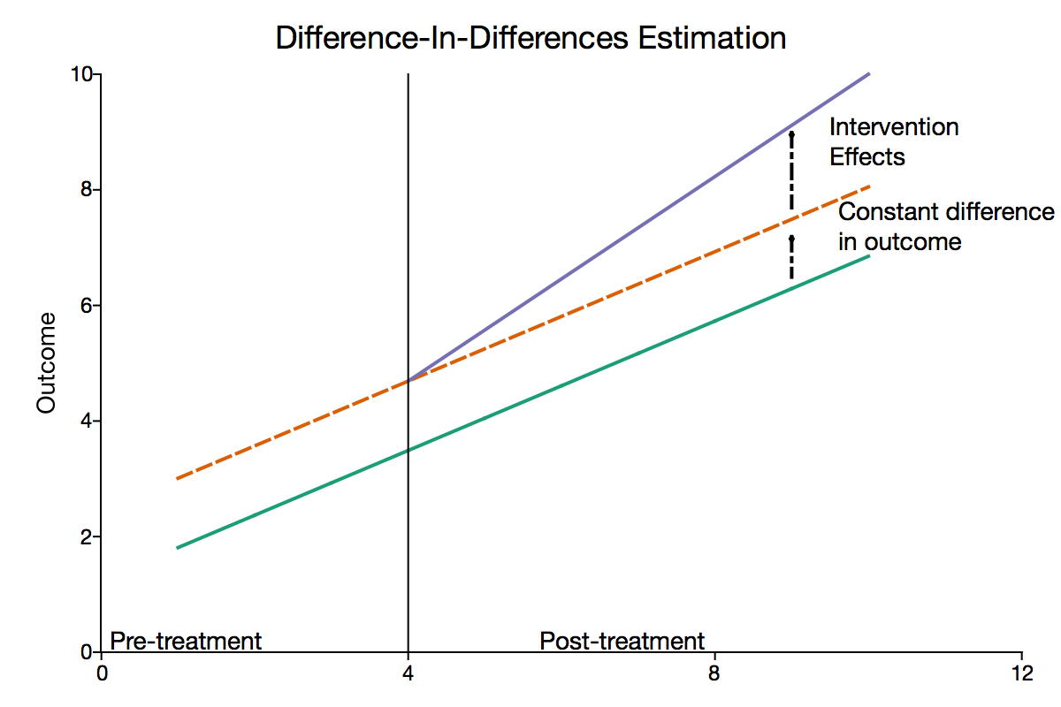
Test 3
Difference in Differences
What is a DiD design?
DiD designs use linear regressions and panel data to examine the differential effect of a treatment (having a dashboard) on a treatment group (universities with dashboards) versus a control group (universities without dashboards) in a natural experiment (investigating change in behavior after implementation of treatment, without random assignment).
Covid cases = α + β₁(Post) + β₂(Treatment) + β₃(Post*Treatment)
Because of DiD’s favorable properties (natural experiment with a control group), it is often used for causal inference where certain conditions are met.

Slide 17
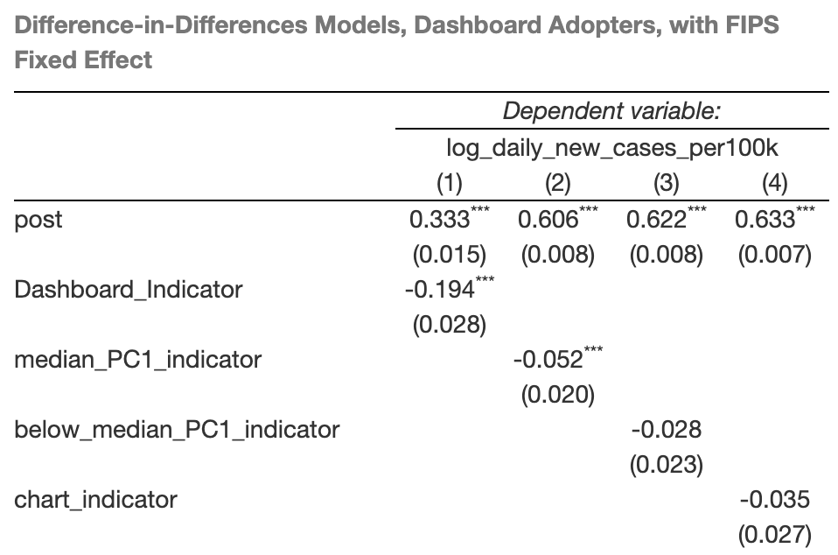
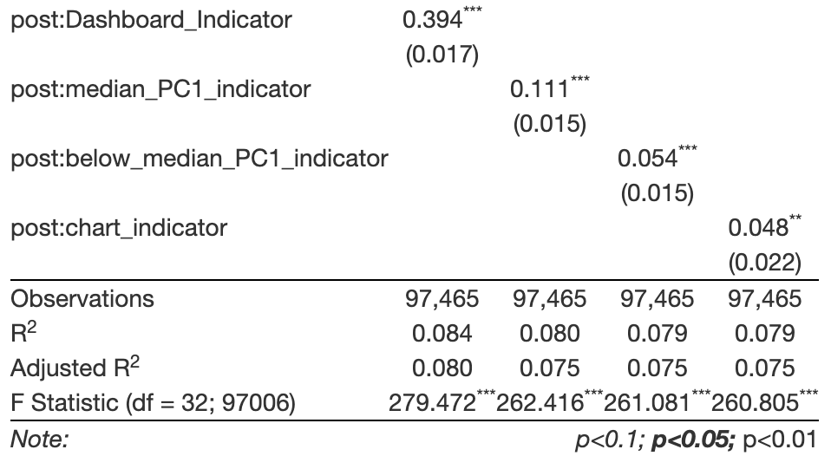
Test 3
Difference in Differences
Dependent variable: Log of daily new county cases per 100k
Post: Indicator variable equal to 1 for all days after the first day of the Fall 2020 semester
Treatment:
Indicator variable equal to 1 if the university has a covid dashboard
Indicator variable equal to 1 for universities with high information content dashboards (as proxied by median PC1’s above the population median)
Indicator variable equal to 1 for universities with low information content dashboards (as proxied by median PC1’s below the population median)
Indicator variable equal to 1 for dashboards with dynamic HTML charts
Fixed effects: County (FIPS)
Other controls: Relevant university specific variables identified using LASSO

Slide 18
Test 3
Interpretation of Results
Again, we see that more information does not necessarily yield better results.
Universities that have covid dashboards (and dynamic HTML content therein) do not do better (in terms of covid cases) than universities that do not have dashboards once the Fall 2020 semester begins (in the post period).
This could imply that universities need to be proactive in managing covid cases through policies and procedures as information disclosure does not seem to be enough.

Slide 19

Thank you!
Any questions?

